Slide 2
Axial-mode wire helix
Antenna 3 : Results

Slide 3
Axial-mode wire helix
Antenna 3 : sketches, objectives and parameters

Slide 4
Antenna Structure: Antenna Parameters
Name | Description
f₀ | Centre frequency
Dw | Wire diameter
Dg | Diameter of the ground plane
Dh | Diameter of the helix
h | Handedness
Hf | Height of the feed-point
N | Number of helix turns
φ | Pitch angle of the helix
X | Device X-dimension
Y | Device Y-dimension

Slide 5
Antenna Structure: Antenna Parameters (2)
Name | Description
Z | Device Z-dimension
Lw | Total wire length

Slide 6
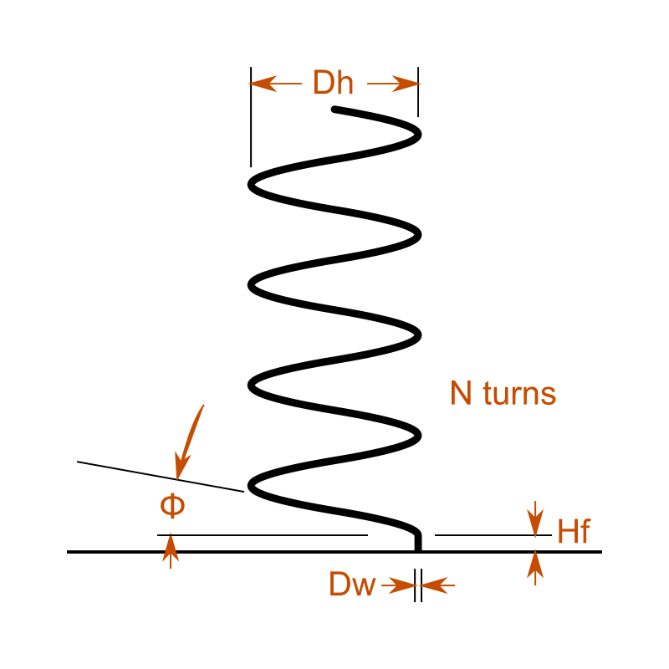
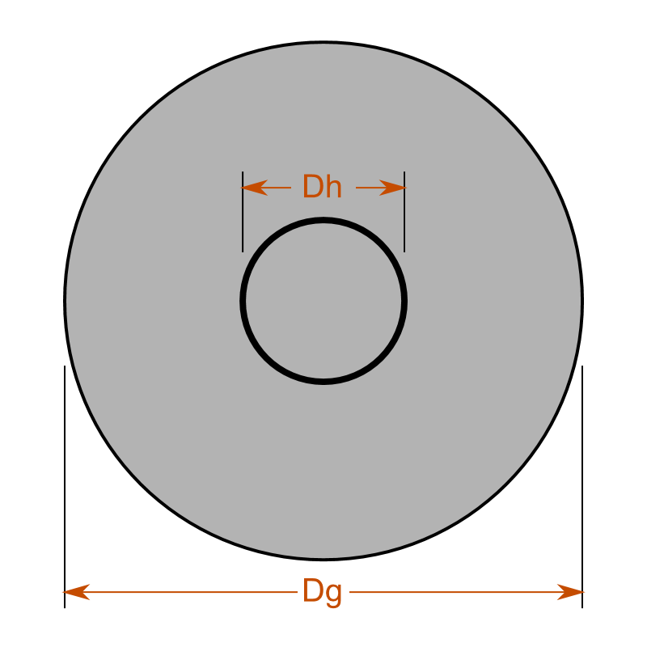
Sketches
Side view
Top view

Slide 7
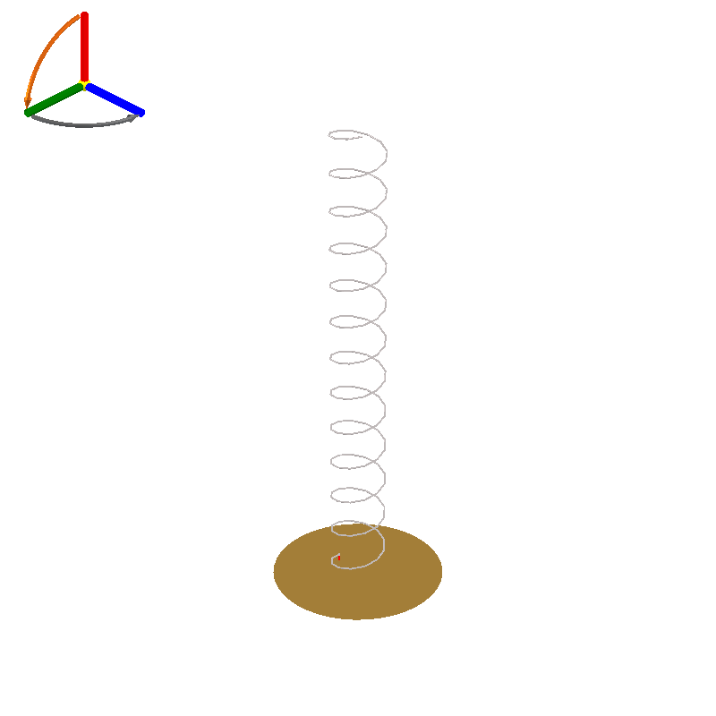
Helical Antenna: Preview

Slide 8
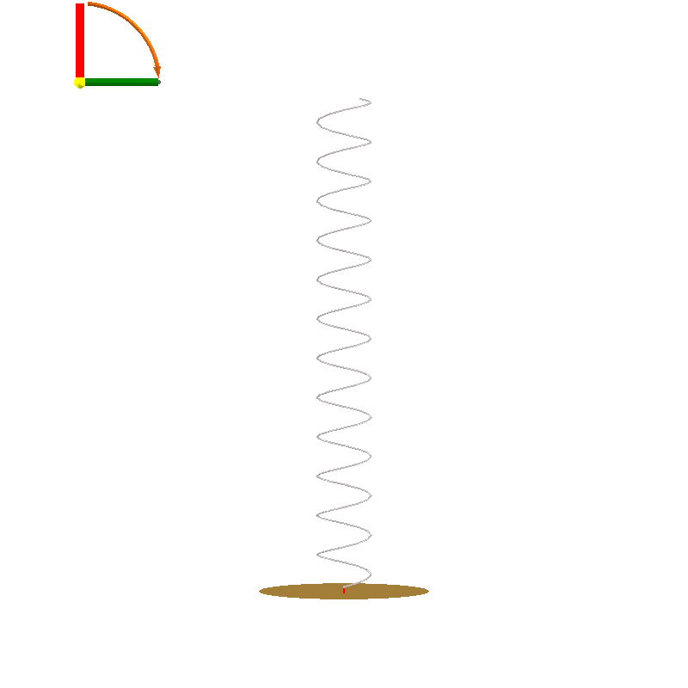
Helical Antenna: Front Side Preview

Slide 9
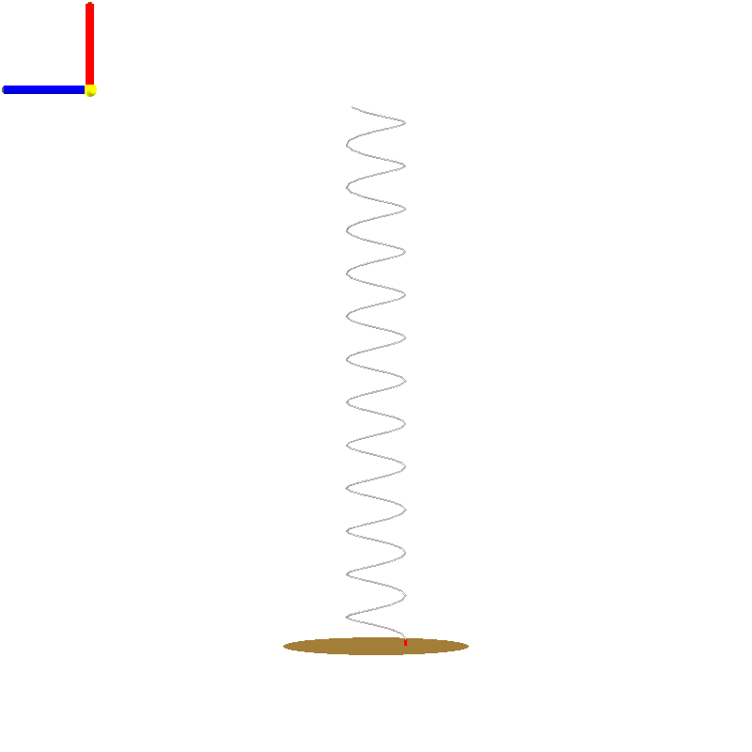
Helical Antenna: Left Side Preview

Slide 10
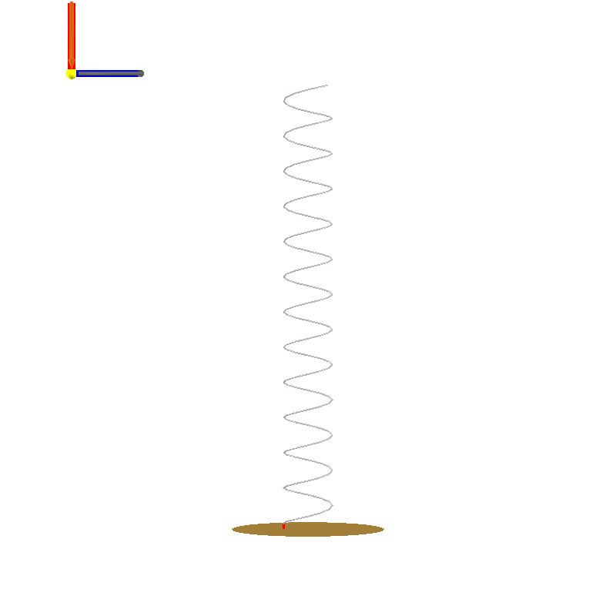
Helical Antenna: Right Side Preview

Slide 11
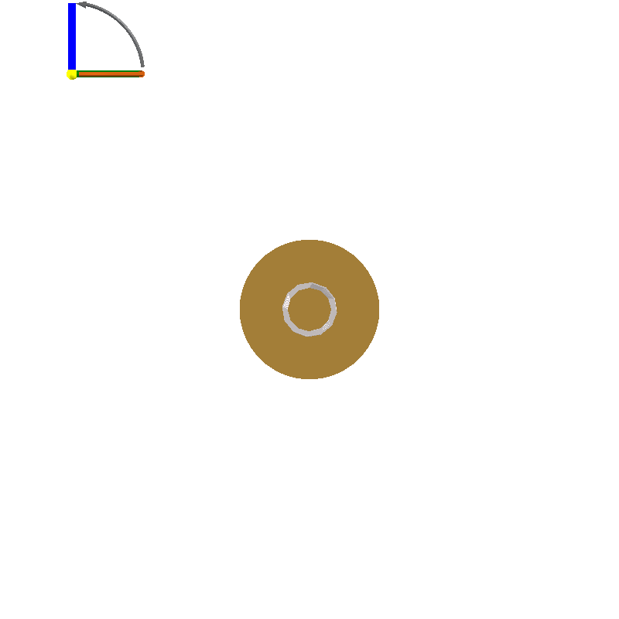
Helical Antenna: Top Side Preview

Slide 12
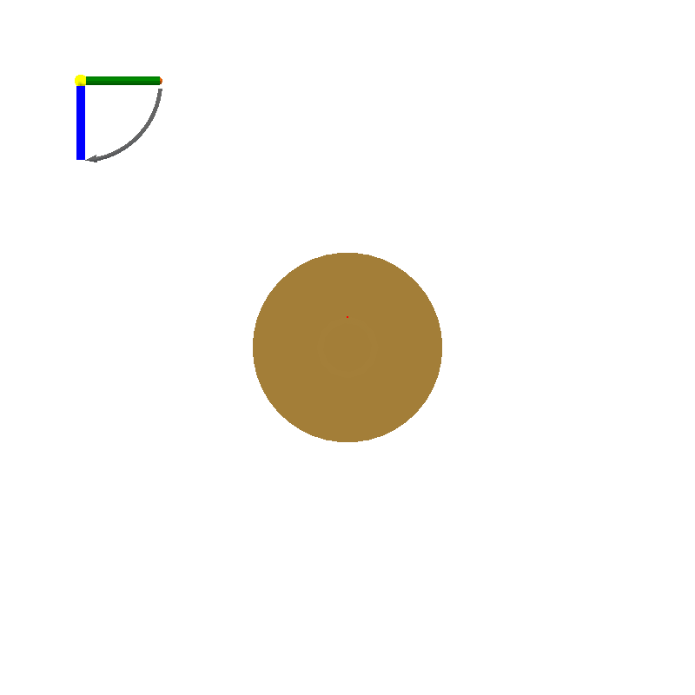
Helical Antenna: Bottom Side Preview

Slide 13
Helical Antenna: Design Objectives
Objective Group: gain and wire diameter
Name | Description | Value
f₀ | Centre frequency | 2.4 GHz
Dw | The desired wire diameter | 1.249 mm
G | Gain | 13 dBi
P | Polarisation (transmitting) | RHC

Slide 14
Helical Antenna: Physical Parameters
Name | Description | Value
Dw | Wire diameter | 1.249 mm
Dg | Diameter of the ground plane | 124.9 mm
Dh | Diameter of the helix | 39.76 mm
h | Handedness | Right
Hf | Height of the feed-point | 4.997 mm
N | Number of helix turns | 12.4
φ | Pitch angle of the helix | 13 °

Slide 15
Helical Antenna: Derived Quantities
Name | Description | Value
X | Device X-dimension | 39.76 mm
Y | Device Y-dimension | 39.76 mm
Z | Device Z-dimension | 362.6 mm
Lw | Total wire length | 1.590 m

Slide 16
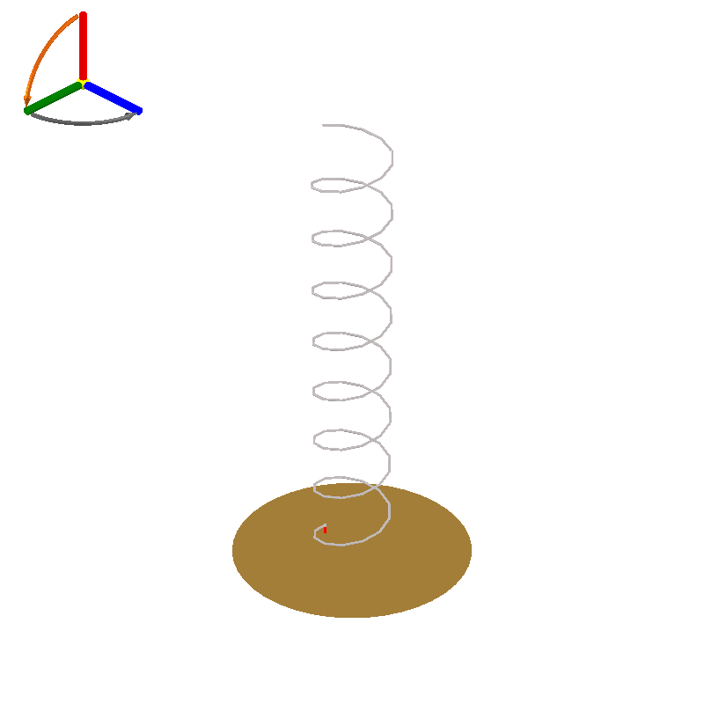
Snapshot 1: Preview

Slide 17
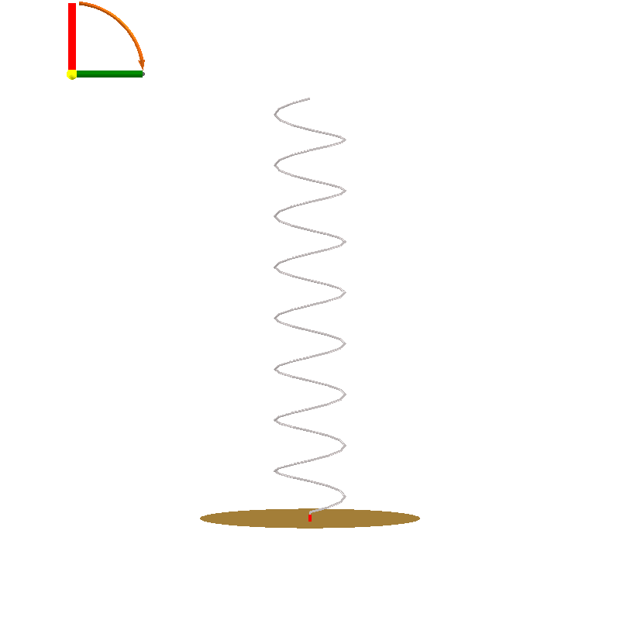
Snapshot 1: Front Side Preview

Slide 18
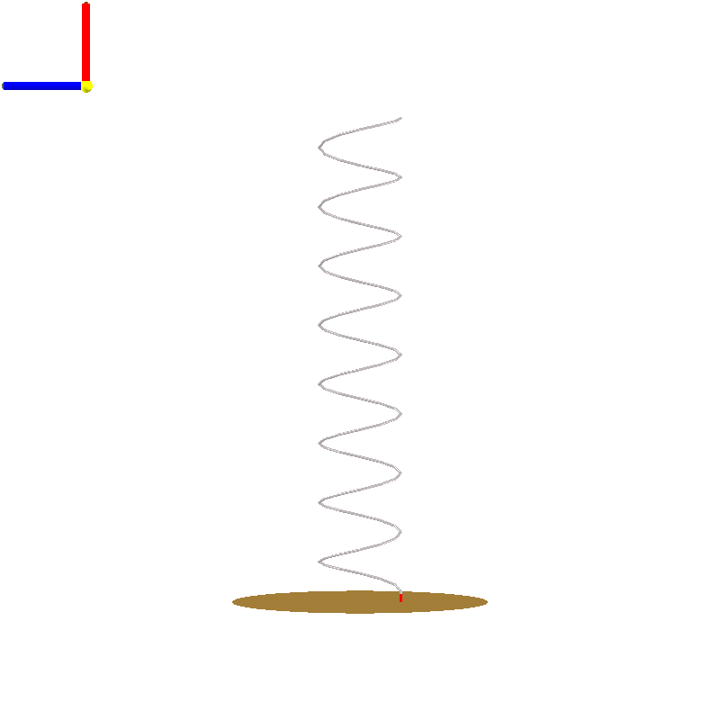
Snapshot 1: Left Side Preview

Slide 19
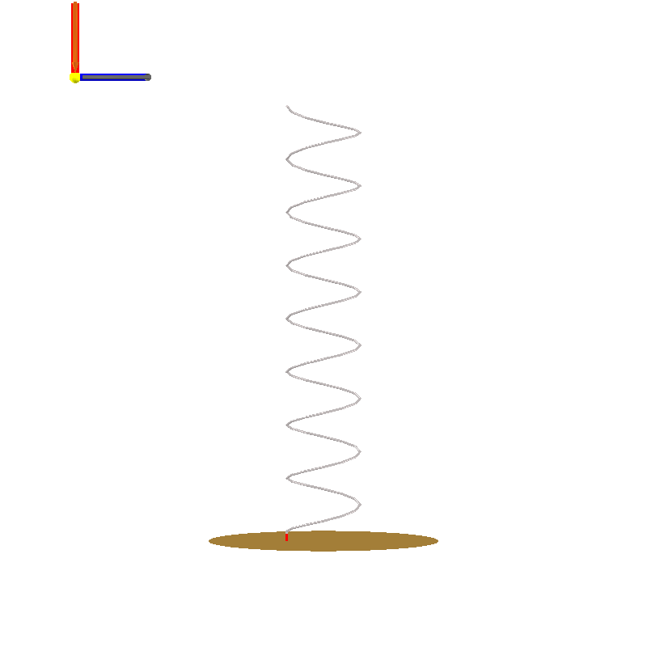
Snapshot 1: Right Side Preview

Slide 20
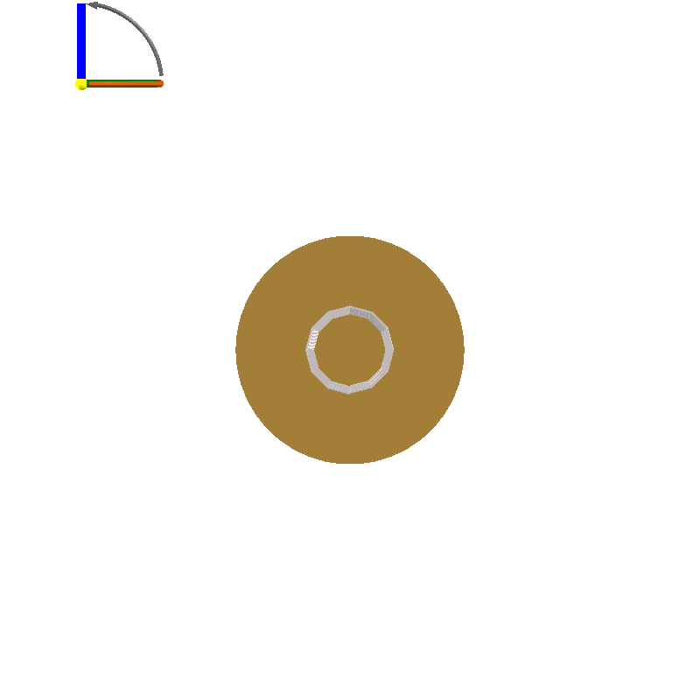
Snapshot 1: Top Side Preview

Slide 21
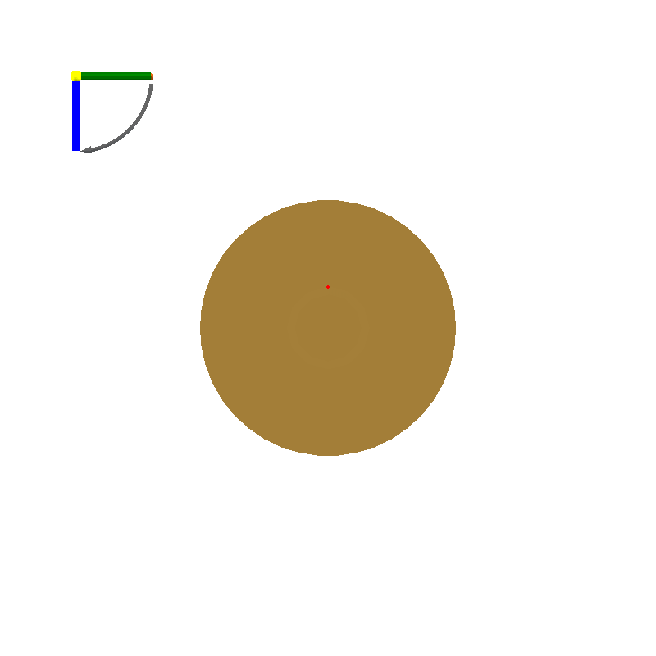
Snapshot 1: Bottom Side Preview

Slide 22
Snapshot 1: Design Objectives
Objective Group: gain and wire diameter
Name | Description | Value
f₀ | Centre frequency | 2.4 GHz
Dw | The desired wire diameter | 1.249 mm
G | Gain | 13 dBi
P | Polarisation (transmitting) | RHC

Slide 23
Snapshot 1: Physical Parameters
Name | Description | Value
Dw | Wire diameter | 1.249 mm
Dg | Diameter of the ground plane | 124.9 mm
Dh | Diameter of the helix | 39.76 mm
h | Handedness | Right
Hf | Height of the feed-point | 4.997 mm
N | Number of helix turns | 8
φ | Pitch angle of the helix | 13 °

Slide 24
Snapshot 1: Derived Quantities
Name | Description | Value
X | Device X-dimension | 39.76 mm
Y | Device Y-dimension | 39.76 mm
Z | Device Z-dimension | 235.7 mm
Lw | Total wire length | 1.026 m

Slide 25
Design 1: Preview

Slide 26
Design 1: Front Side Preview

Slide 27
Design 1: Left Side Preview

Slide 28
Design 1: Right Side Preview

Slide 29
Design 1: Top Side Preview

Slide 30
Design 1: Bottom Side Preview

Slide 31
Design 1: Design Objectives
Objective Group: beamwidth and wire diameter
Name | Description | Value
f₀ | Centre frequency | 2.4 GHz
Dw | The desired wire diameter | 1.249 mm
bw | 3dB beamwidth | 45 °
P | Polarisation (transmitting) | RHC

Slide 32
Design 1: Physical Parameters
Name | Description | Value
Dw | Wire diameter | 1.249 mm
Dg | Diameter of the ground plane | 124.9 mm
Dh | Diameter of the helix | 39.76 mm
h | Handedness | Right
Hf | Height of the feed-point | 4.997 mm
N | Number of helix turns | 8
φ | Pitch angle of the helix | 13 °

Slide 33
Design 1: Derived Quantities
Name | Description | Value
X | Device X-dimension | 39.76 mm
Y | Device Y-dimension | 39.76 mm
Z | Device Z-dimension | 235.7 mm
Lw | Total wire length | 1.026 m

Slide 34
Axial-mode wire helix
Antenna 3 : estimated performance charts

Slide 35
Impedance vs Frequency

Slide 36
Impedance vs Frequency

Slide 37
Impedance vs Frequency
Reflection coefficient (20log|Γ|)
 | Helical Antenna
Reference impedance @ port 1 | (140+0j) Ω

Slide 38
Impedance vs Frequency

Slide 39
Impedance vs Frequency
VSWR
 | Helical Antenna
Reference impedance @ port 1 | (140+0j) Ω

Slide 40
Far Field vs Angle @ f0

Slide 41
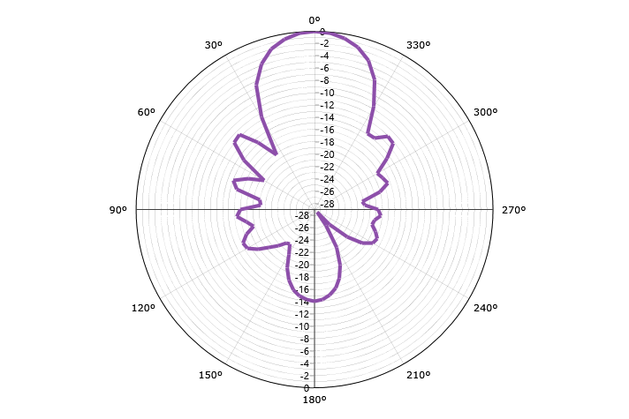
Far Field vs Angle @ f0
Gain (Total - normalised)

Slide 42
Far Field vs Angle @ f0

Slide 43
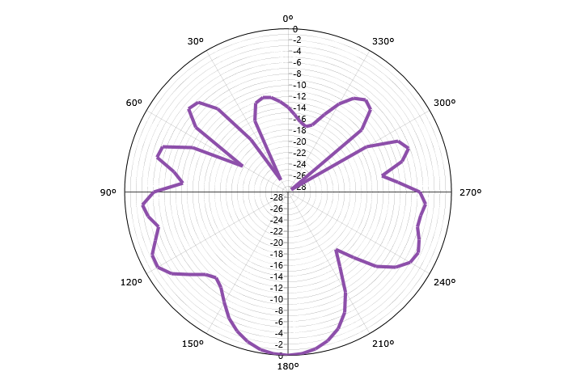
Far Field vs Angle @ f0
Gain (LHC - normalised)

Slide 44
Far Field vs Angle @ f0

Slide 45
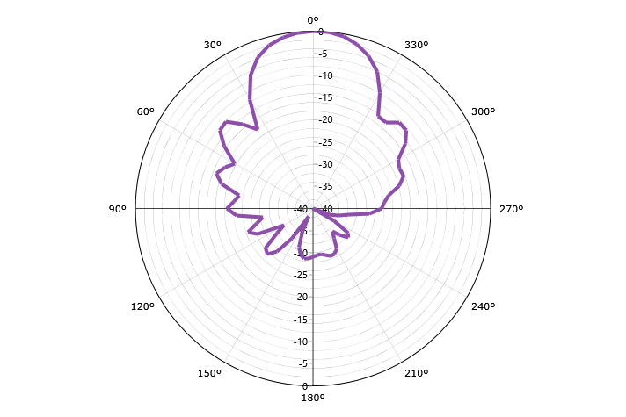
Far Field vs Angle @ f0
Gain (RHC - normalised)

Slide 46
Far Field vs Angle @ f0

Slide 47
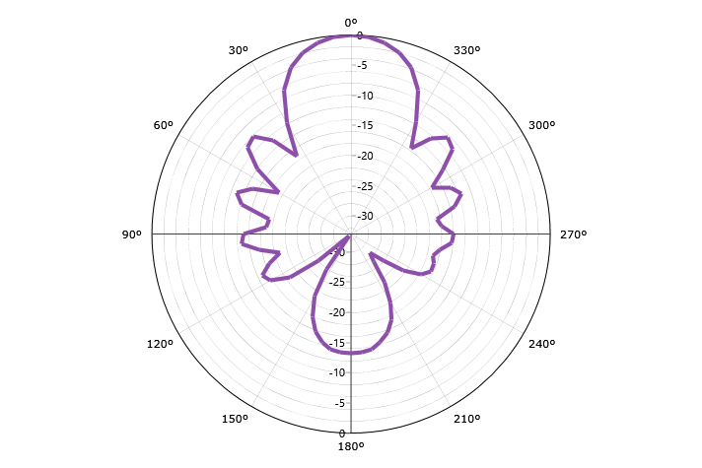
Far Field vs Angle @ f0
Gain (Horizontal - normalised)

Slide 48
Far Field vs Angle @ f0

Slide 49
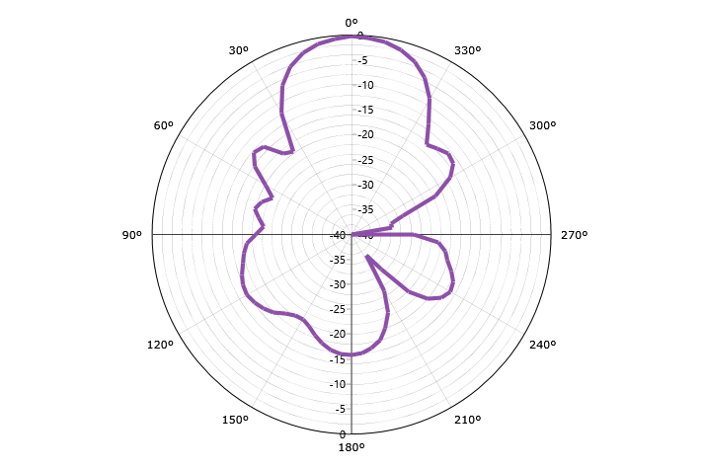
Far Field vs Angle @ f0
Gain (Vertical - normalised)

Slide 50
Far Field vs Angle @ f0

Slide 51
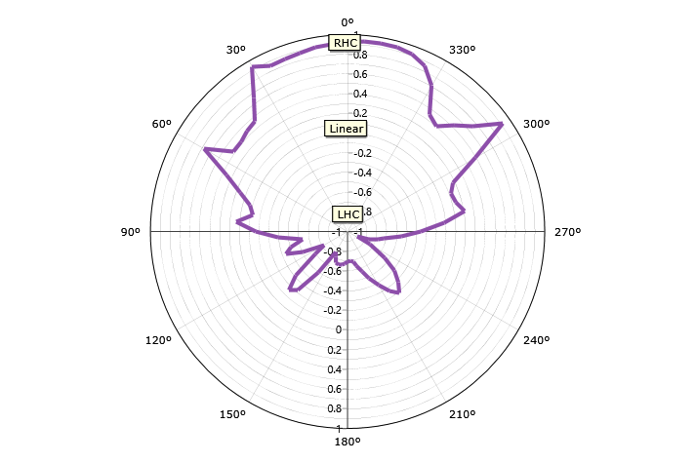
Far Field vs Angle @ f0
Axial Ratio (Handed)

Slide 52
Far Field vs Angle @ f0

Slide 53
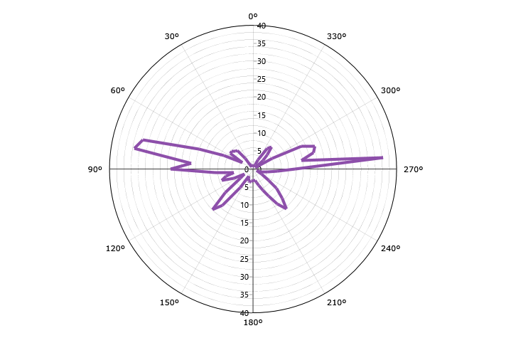
Far Field vs Angle @ f0
Axial Ratio (IEEE)

Slide 54
Far Field vs Angle @ f0

Slide 55
Far Field vs Angle @ f0
Ludwig III (Co)

Slide 56
Far Field vs Angle @ f0

Slide 57
Far Field vs Angle @ f0
Ludwig III (Cross)

Slide 58
Far Field vs Frequency

Slide 59
Far Field vs Frequency

Slide 60
Far Field vs Frequency

Slide 61
Far Field vs Frequency

Slide 62
Far Field vs Frequency

Slide 63
Far Field vs Frequency

Slide 64
Far Field vs Frequency

Slide 65
Far Field vs Frequency

Slide 66
Far Field vs Frequency

